Slide 1
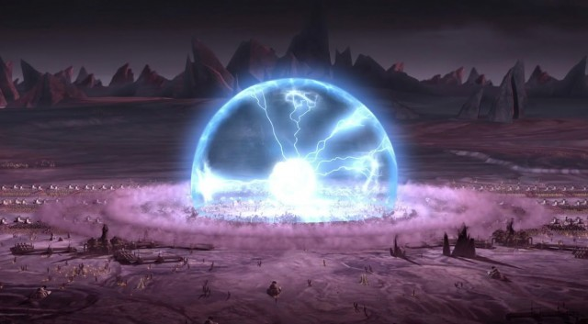
Propulsion Grant Proposal
EMP Dome
A Design for Using Electromagnetic Pulse Arrays as Defensive Force Fields
Challenge: May the Force (Field) Be with You
November 1st, 2018
PI: Nick Kantack
Image from https://www.extremetech.com/extreme/170563-north-korea-emp

Slide 2
Sector Challenge and Disruptive Impact
Effective mega-raid force field defenses must:
Require minimal targeting/aim
Be self-protecting
Minimize hard-kill cost
Be safe for the assets they protect
An Electromagnetic Pulse (EMP) force field can accomplish (most) of these goals.
An Electromagnetic Pulse is a short, high intensity electromagnetic wave which can damage or destroy electronics by inducing high voltage/current responses which exceed device tolerances.
Why don’t EMP force field already exist?
Asset Protection Problem – Must operate in the vicinity of assets without threatening them
Useful Range – Must interfere with attackers while they are far from assets
EMP Dome addresses these barriers with:
Distributed, synchronized generators for defensive, destructive interference, solving the Asset Protection Problem
Ultrathin Marx Generator design to
Minimize skin effect losses and vastly increase array energy density and effective range
Facilitate high accuracy discharge timing for phase synchronization

Slide 3
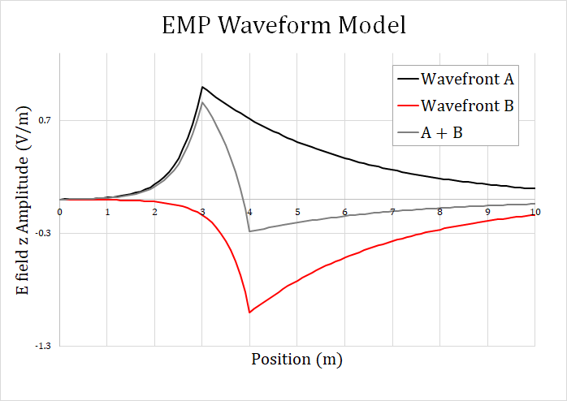
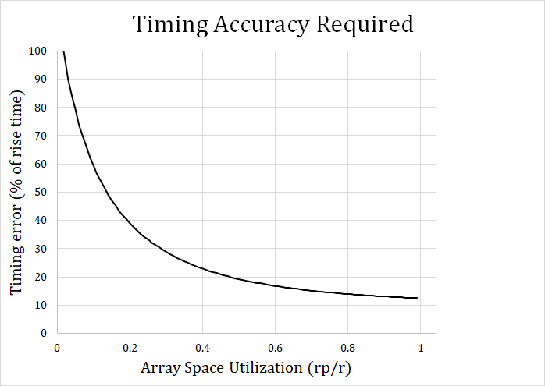
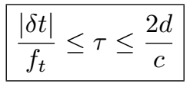
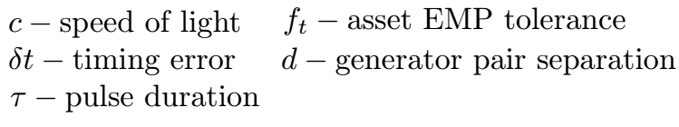
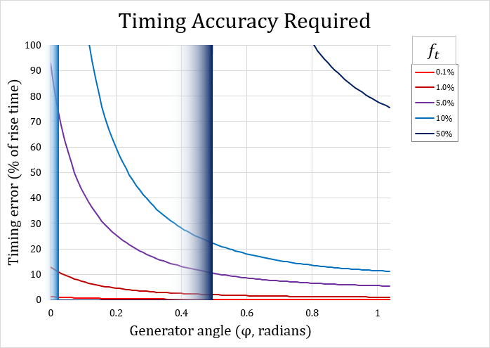
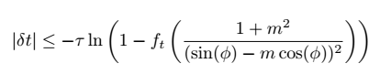
Technical Approach (1/3)
Solving the Asset Protection Problem
Use destructive interference to accomplish this: EMP Simulation
Theoretical derivation of array constraints and requisite timing accuracy
Use dipole radiation pattern to lower synchronization requirement
Goal: Tolerate a 1 ns timing error
Reaching the 1 ns timing error goal
Robust theoretical derivation of timing constraints
Accurate, sophisticated simulation to test robustness
A photonic triggering system to minimize timing error
Innovation on pulse generator design to reduce timing inaccuracy

Slide 4
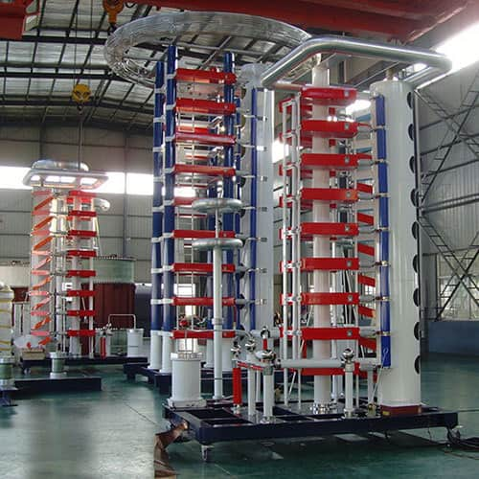
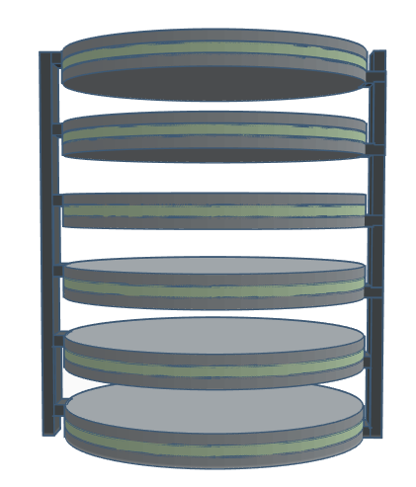
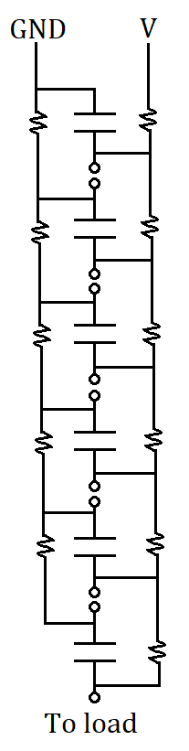
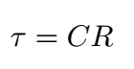
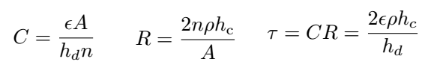
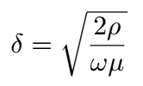
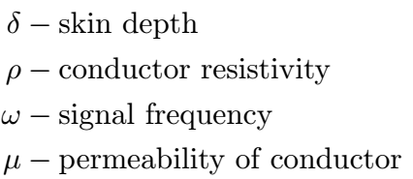
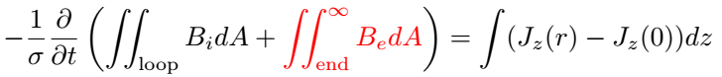



Technical Approach (2/3)
Marx Generator Design
Tradeoff between power and rise-time
Thin slice construction to decouple energy and pulse duration
Problem: Skin effect
Copper, 60 Hz, δ = 8mm
Copper, 300 MHz, δ = 10μm
Solution: Ultrathin design
Skin effect extinction – Restrict eddy currents
Effective conductor area increases by orders of magnitude!
$$I$$
$$B$$
http://www.hvbrighter.com/impulse-voltage-generator-3578369.html
$$I$$
$$B$$

Slide 5
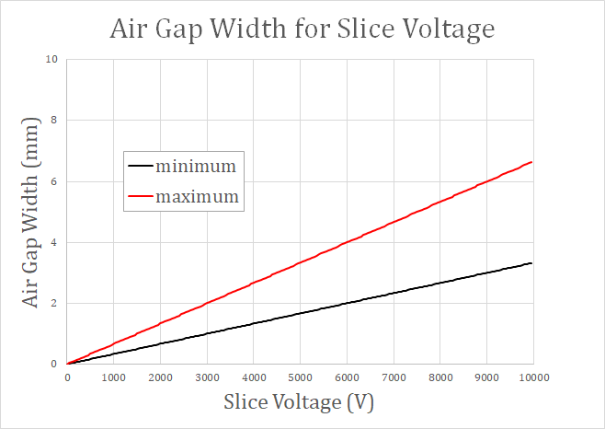
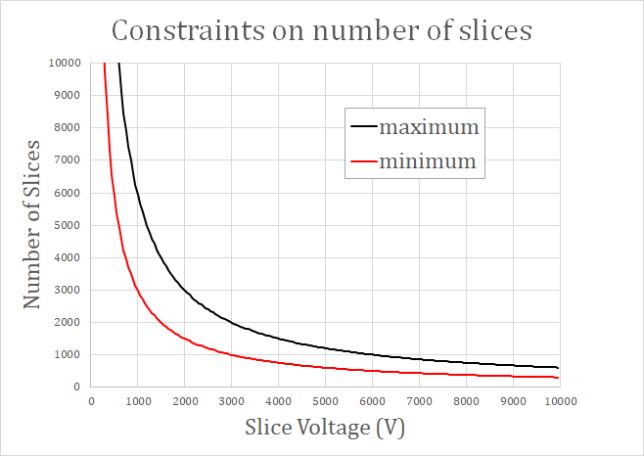
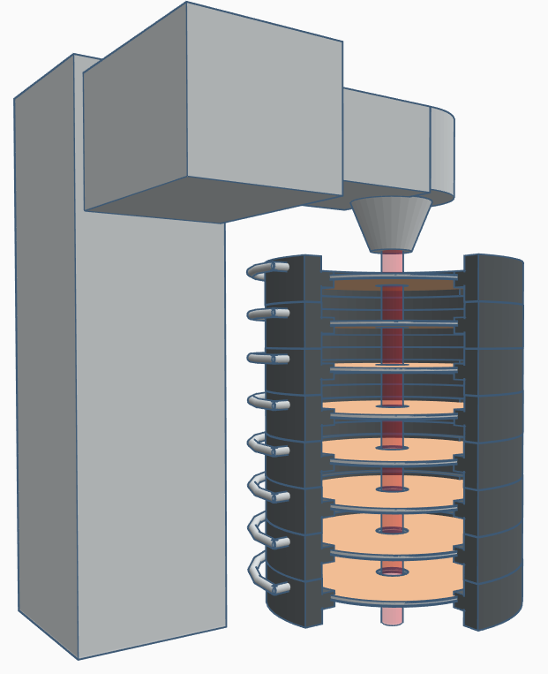
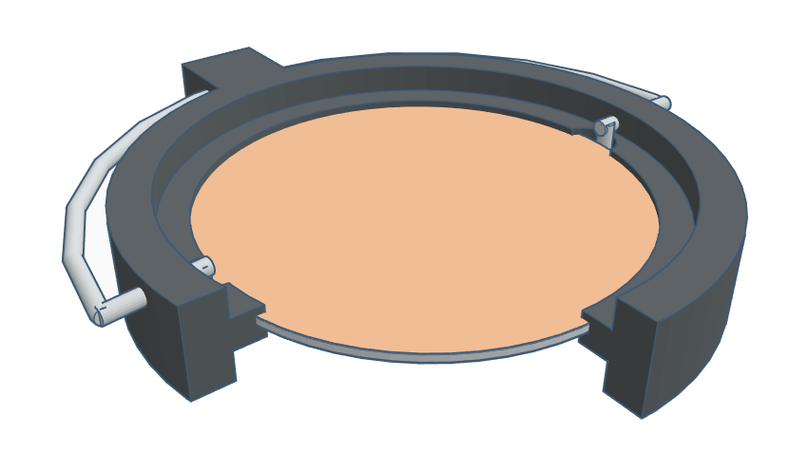
Technical Approach (3/3)
Generator
Stack
Marx Generator Construction Specifications
Slice voltage ~10kV
Air gap ~3mm
Max number of slices ~700 (350 / meter)
Max discharge voltage ~7MV
Max energy stored ~17MJ
Estimated range of effect for entire array ~1.5 km
Generator Designs
Evaporation deposit 1-100 micron thick copper electrodes
Thick dielectric design (~1 mm)
Purchase crystal wafer of desired thickness
Thin dielectric design (~1 micron)
Spin coat dielectric on dissolvable substrate
Ultrathin design (~10nm)
Deposit dielectric via molecular beam epitaxy
Photonic triggering
Laser/fiber optic transmission of signal
Laser assisted spark gap actuation
Insulative case
Cu electrodes
Laser optics
Charging leads
TiO2 dielectric
Laser beam

Slide 6
Novelty and Technical Soundness
What makes EMP Dome unique?
EMP as a shield, not a payload (CHAMP missile[1])
New technology featured in EMP Dome
EMP generator array for force field geometry (phase synchronization)
Ultrathin, energy-dense Marx generator utilizing skin effect extinction
Photonic assisted dielectric collapse of air gaps for high speed discharge
Will EMP Dome really work?
Photonic triggering
Real world photonic systems are more than accurate enough for EMP Dome (femptoseconds [2])
Not required for EMP Dome to work (can be constructed for infinite timing error tolerance)
Skin effect extinction
A known phenomenon, used in transformer design [3]
Can derive the existence of skin effect extinction from Maxwell’s Equations [4]
Pulse synchronization
Not required for EMP Dome to work, but would be beneficial
A 1 ns timing accuracy is feasible and sufficient for most synchronization benefits
[1] CHAMP http://mil-embedded.com/news/raytheon-emp-missile-tested-by-boeing-usaf-research-lab/
[2] Development of timing synchronization between RF source and laser
https://ieeexplore.ieee.org/document/817908
[3] SKIN EFFECT, PROXIMITY EFFECT, AND LITZ WIRE https://www.dartmouth.edu/~sullivan/litzwire/skin.html
[4] A simple derivation for the skin effect in a round wire
http://iopscience.iop.org/article/10.1088/0143-0807/35/2/025002

Slide 7
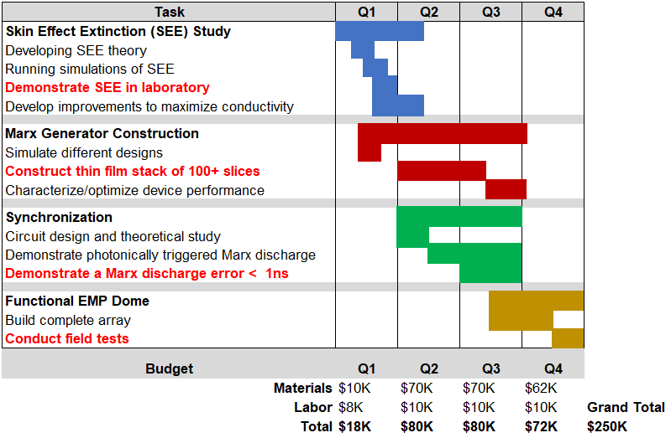
Objectives, Schedule, Budget and Staff
Deliverables are in red
Overall Objective: Construct and characterize a pulse synchronized EMP array utilizing thin film circuitry and a photonic triggering system.
FY20 – Develop and/or employ specialized materials for optimized power, speed, accuracy and regenerative capacity of the EMP Dome design.
FY21 – Expand the force field concept to design variants which are mobile, more specialized, and potentially offensive.

